Slide 1


LEARNZY – an E-learning platform
Team 2- Gen Risers

Slide 2


Agenda
Objective
Motivation
Landing page
Sign up and login pages
Dashboards

Slide 3

Objective
The main objective is to provide a platform where students can easily connect with qualified tutors for a personalized learning experience through one-on-one video sessions.
The goal is to provide a comprehensive learning platform where students can review their performance, track their progress and attend classes online to enhance learning experience and achieve educational goals

Slide 4
Motivation
The motivation behind this e-learning website with added features of performance review, progress tracking, and video sessions is to leverage technology to create a dynamic and interactive learning environment.
The website recognizes the importance of appropriate tutor selection, progress monitoring, and the flexibility of remote learning providing students with a seamless and engaging online education experience.

Slide 5
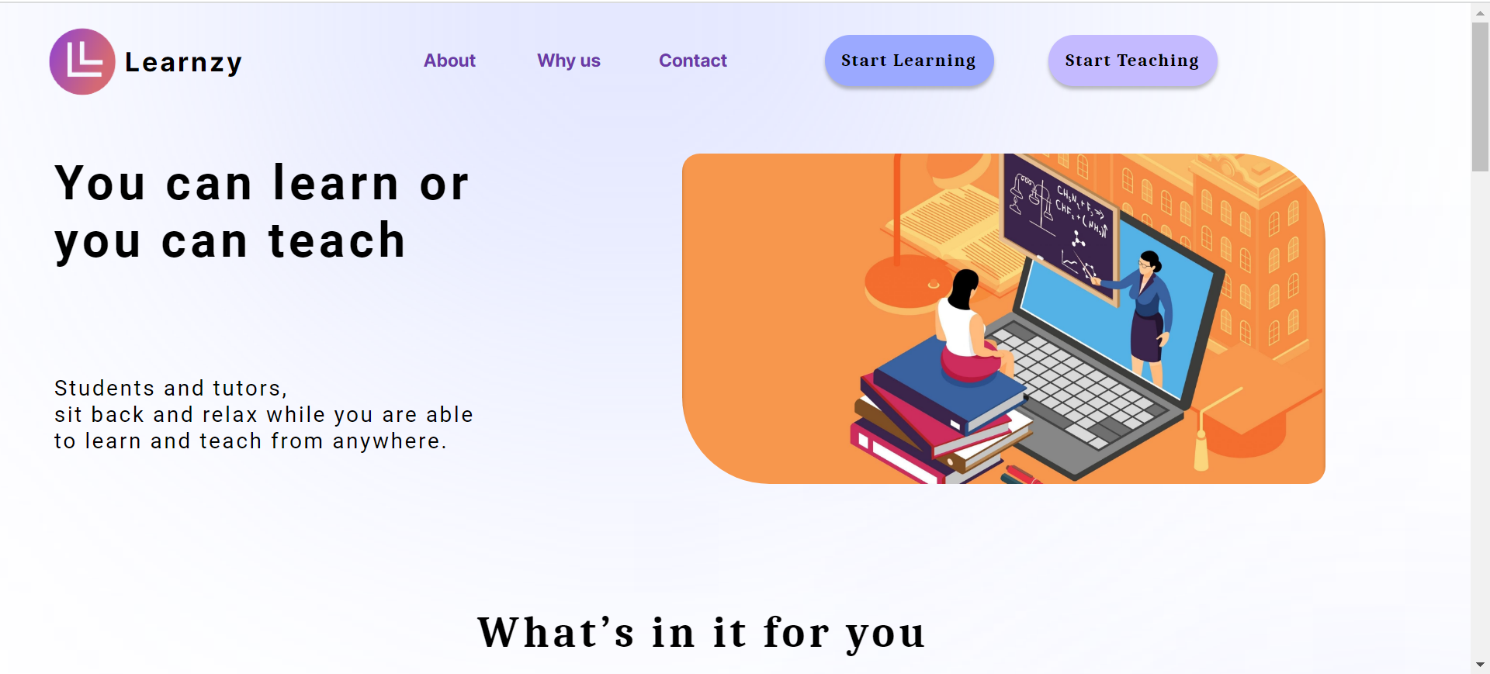
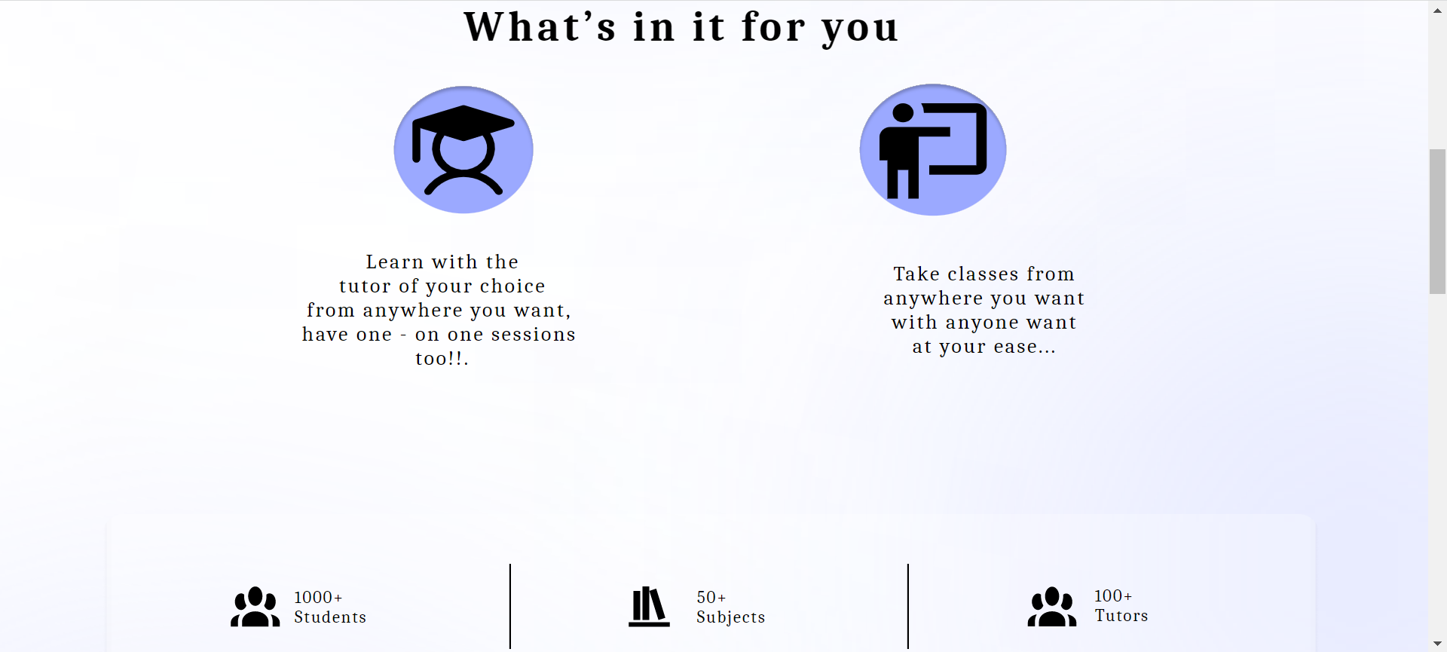
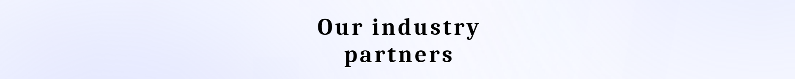
Landing Page
The landing page is the first page that appears when the user clicks on the Learnzy website link. It has the website logo and gives the idea about the website’s objective.
It has details about the approximate number of students, tutors and subjects registered
It also shows the customer reviews, industry partners and contact offices.
It has the About and Why us pages that tell details about learnzy and why customers should choose in comparison to any other learning platform.
It mainly contains the Start Teaching and Start Learning buttons to sign up or login as Tutor or Student respectively.

Slide 6
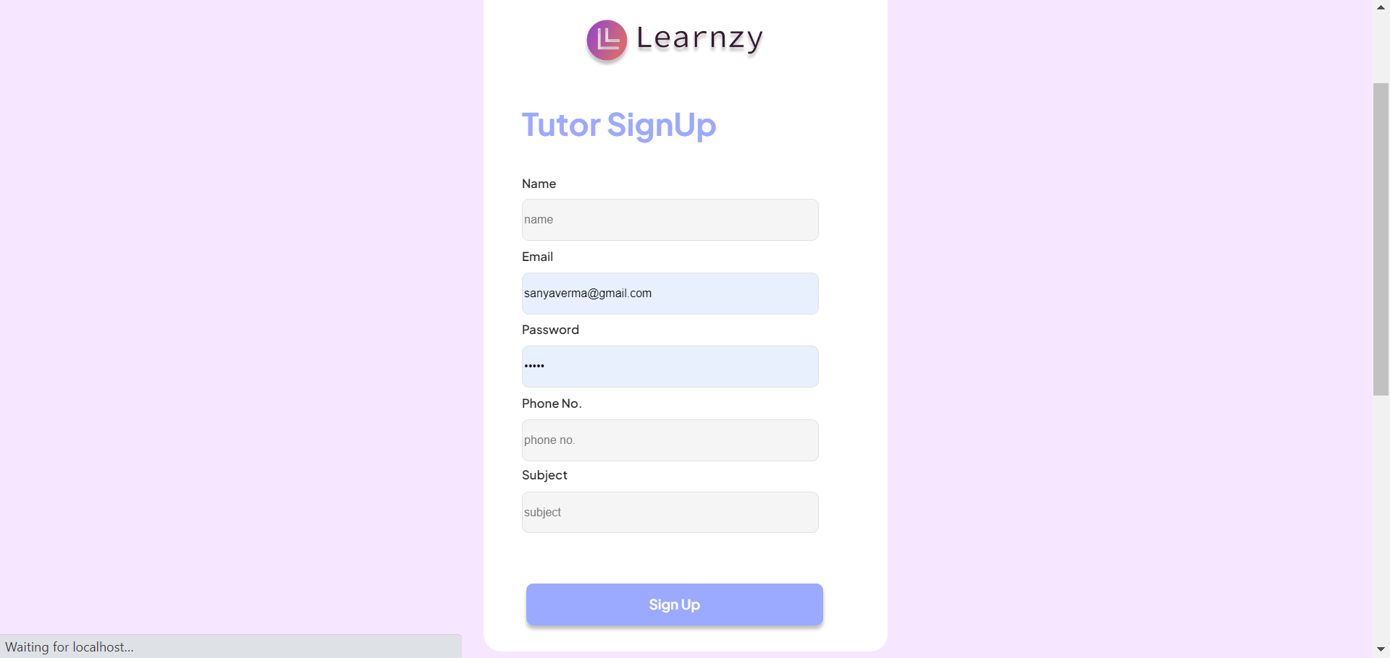

Sign-up and Login page:
Tutor
The Tutor sign up page asks the user for basic details like name, age, email, number, location etc for onboarding
After the sign-up details are filled, a tutor is directed to the tutor dashboard.
After an account is created it is stored in the database and the admin can see the registered tutors.
If the tutor is a registered tutor, he/her can login to the website with their credentials.
A tutor profile is registered only when approved by the admin/management. This facilitates filtering such that only genuine and qualified tutors reach the students.

Slide 7
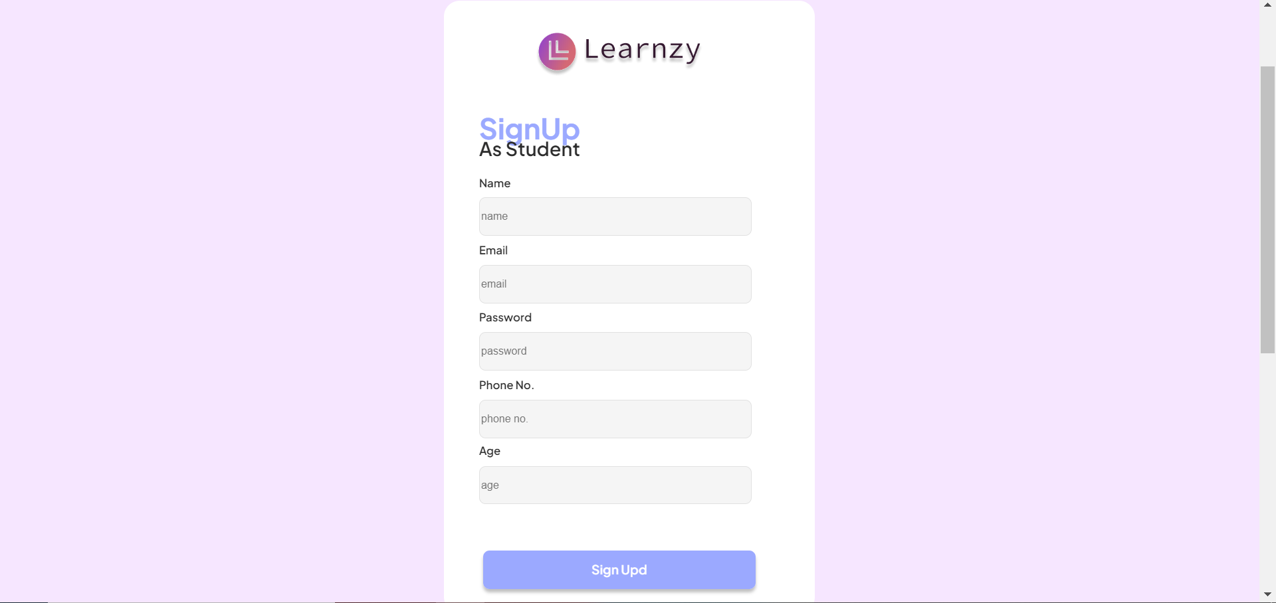
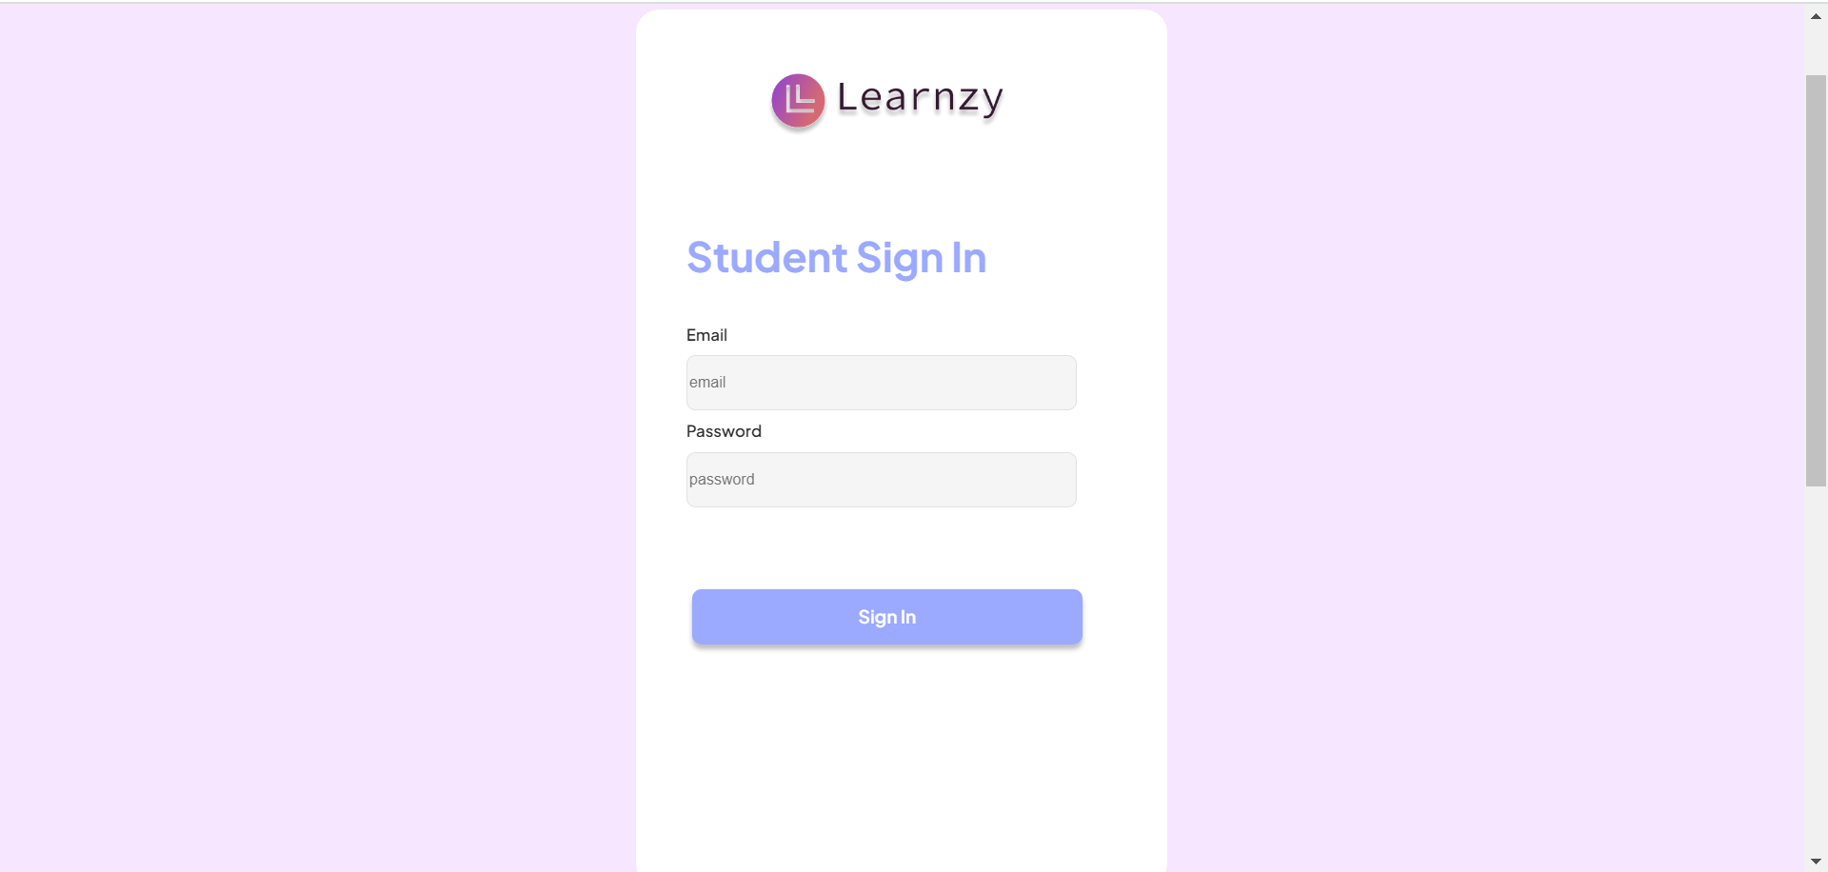
Sign-up and Login page:
Student
In the similar way, the Student sign up page asks the user for basic details like name, age, email, number, location etc for onboarding
If the student is a registered student, he/her can login to the website with their credentials.
After the sign-up details are filled, a student is directed to the student dashboard.
The Admin can only login to the website using their unique credentials. On logging on, the admin is directed to the admin dashboard

Slide 8
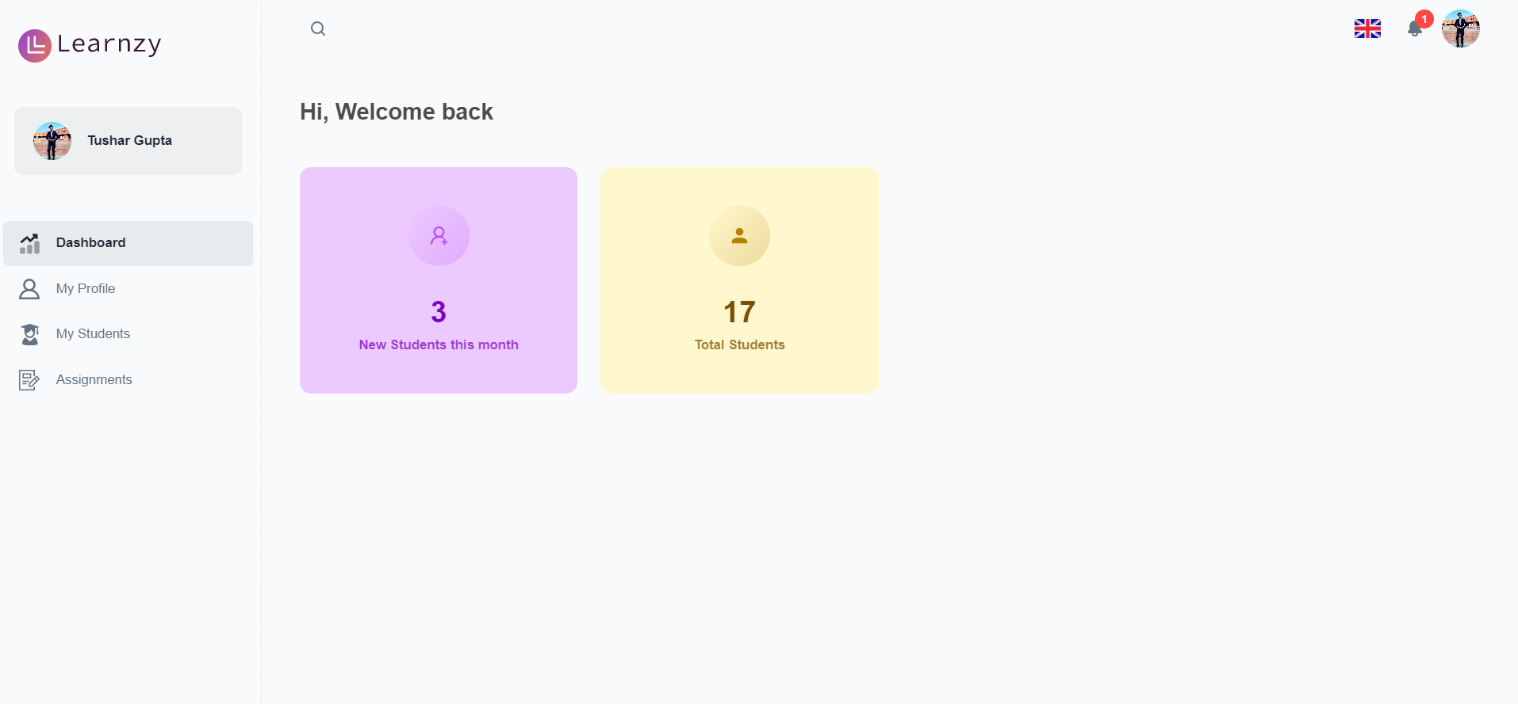
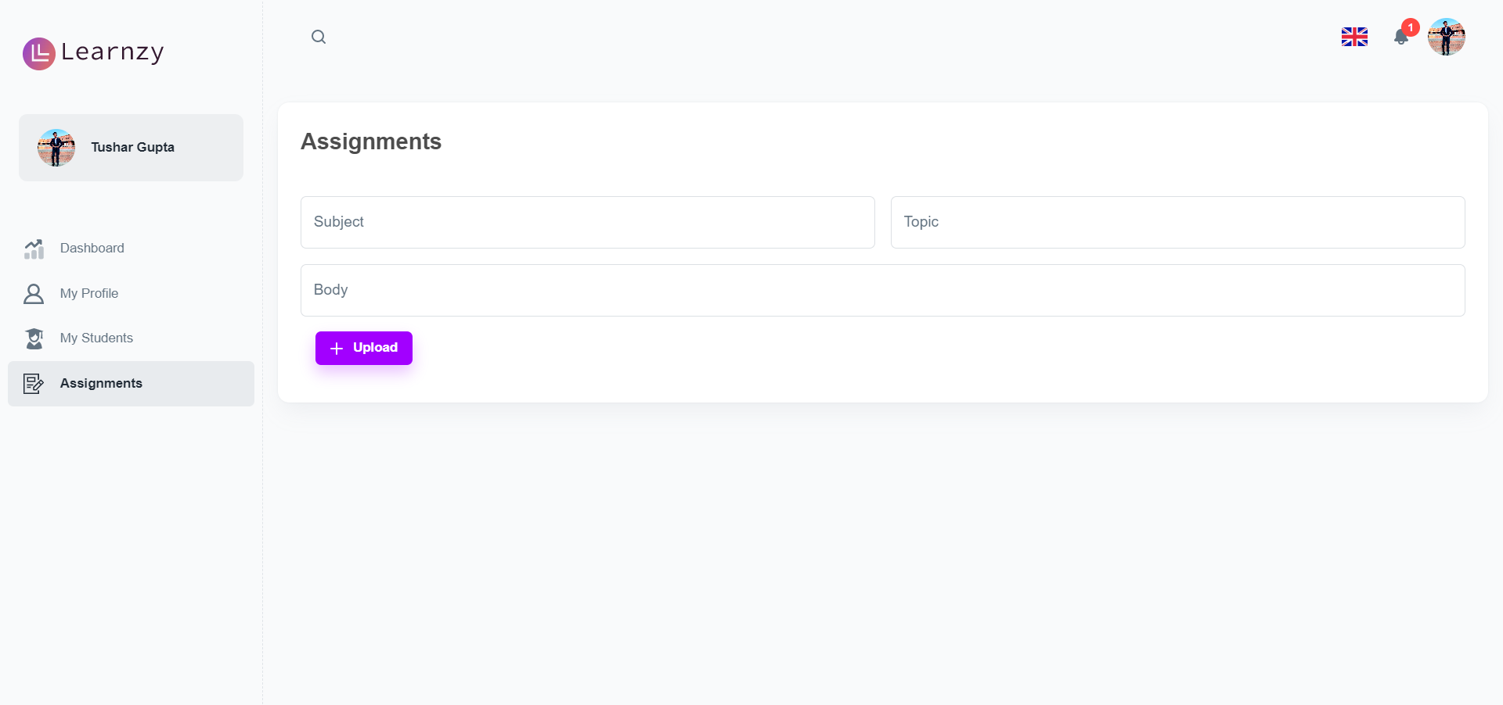
Tutor Dashboard
The tutor dashboard has a few statistics
in the dashboard like the total number of
students and new students joined.
The My profile section has the basic details specific to that tutor like the subject of expertise, hourly wage, etc. These details can be edited and updated in their profile section.
The My Students section has the list of students that the particular tutor is tutoring.
In the Assignments section a tutor can upload assignments for different subjects which the students can see and
complete.

Slide 9
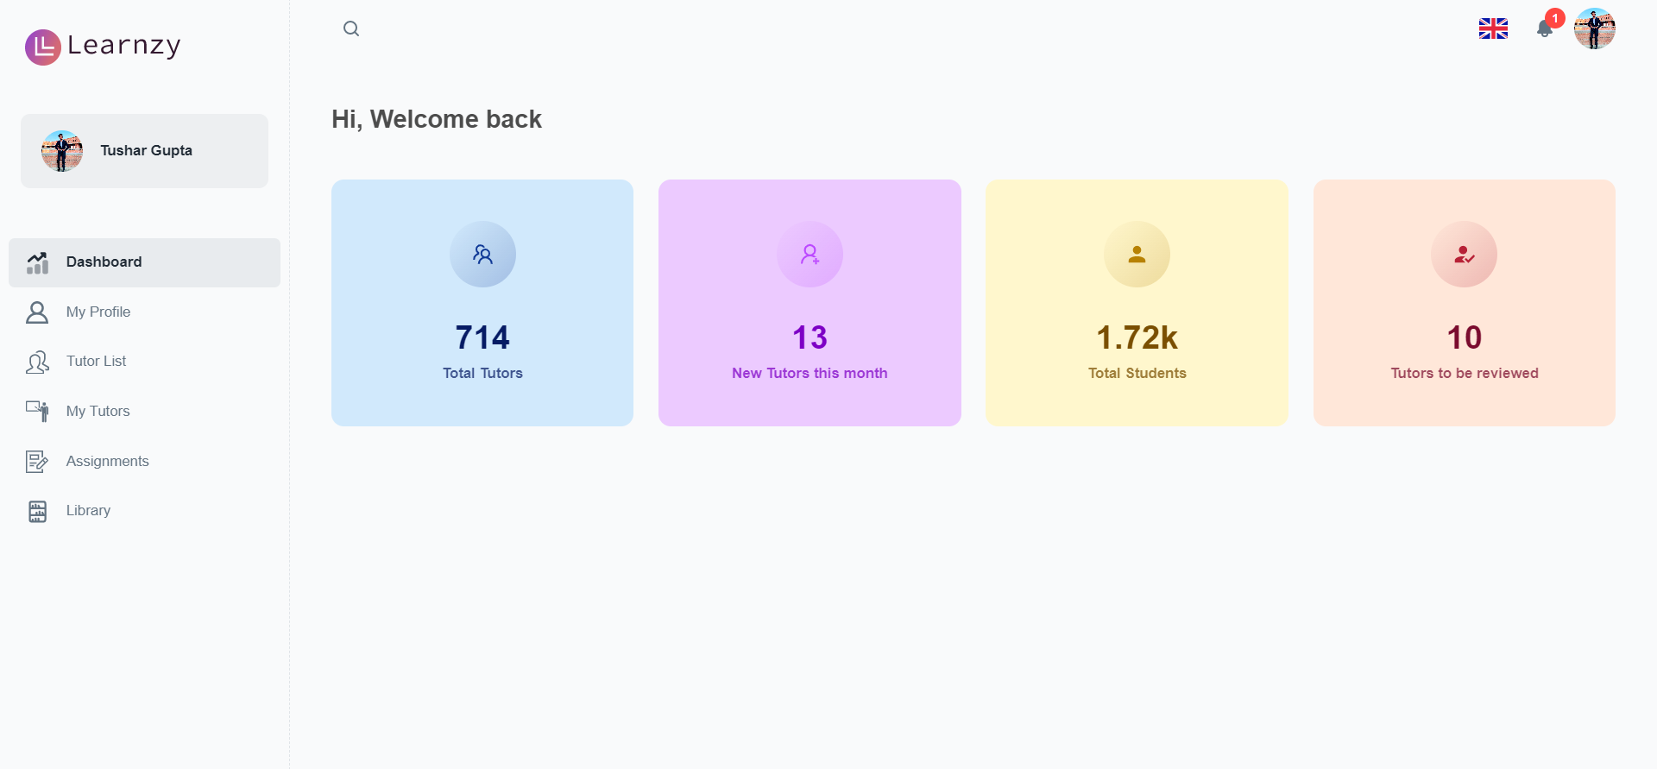
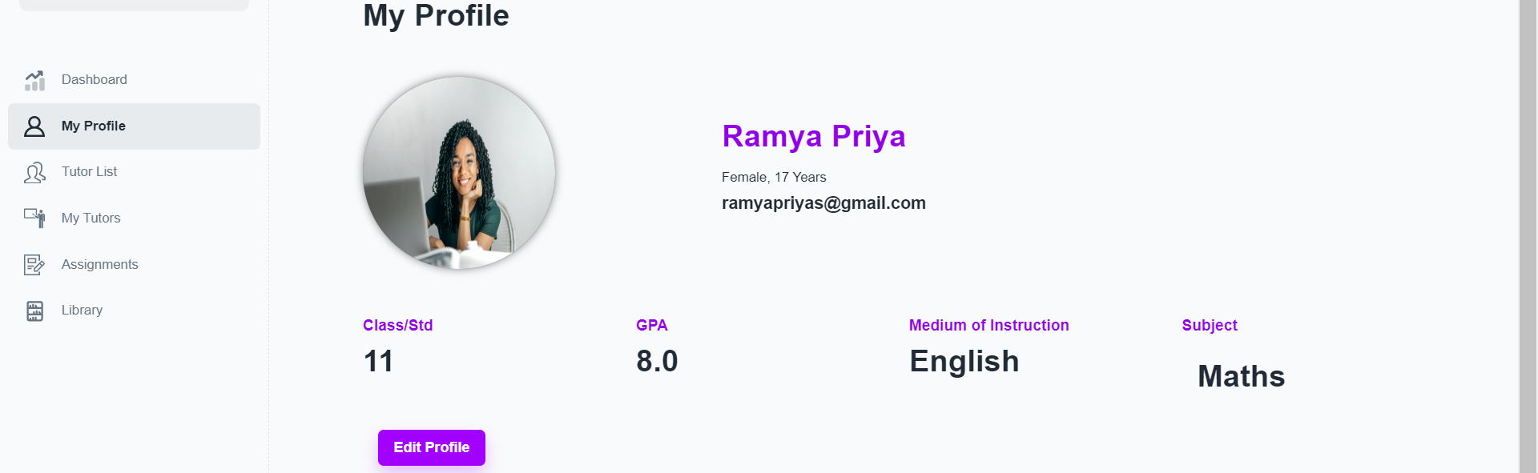
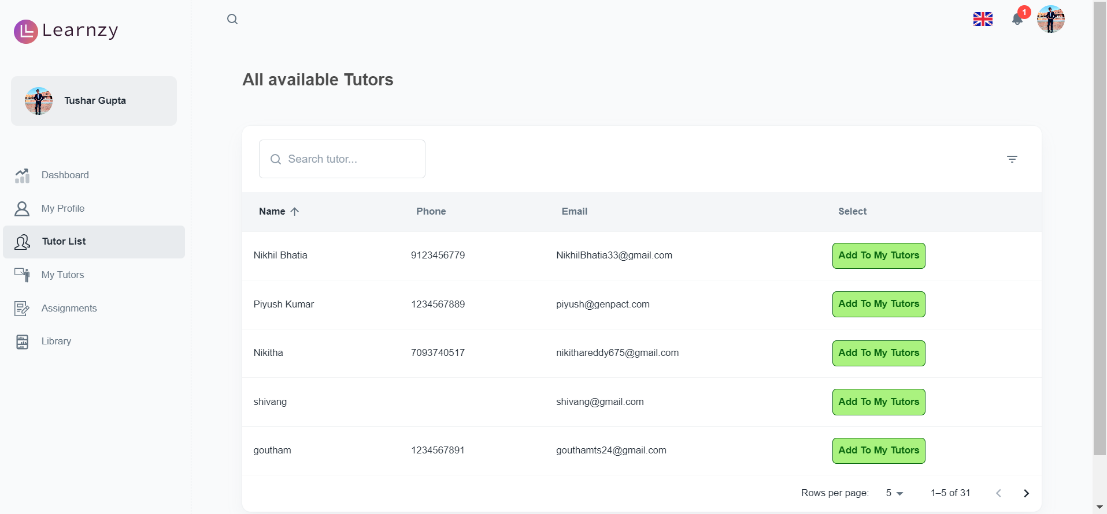
Student Dashboard
The student dashboard has the My profile section has the basic details specific to that student like the class, GPA, subjects learning, etc. which can be edited and updated in their profile section.
The Tutor list section has the list of tutors on which a student can select the desired tutors. The tutors selected are added to the My Tutors section in the dashboard.
In the Assignments section a tutor can upload assignments for different subjects which the students can see and
complete.

Slide 10
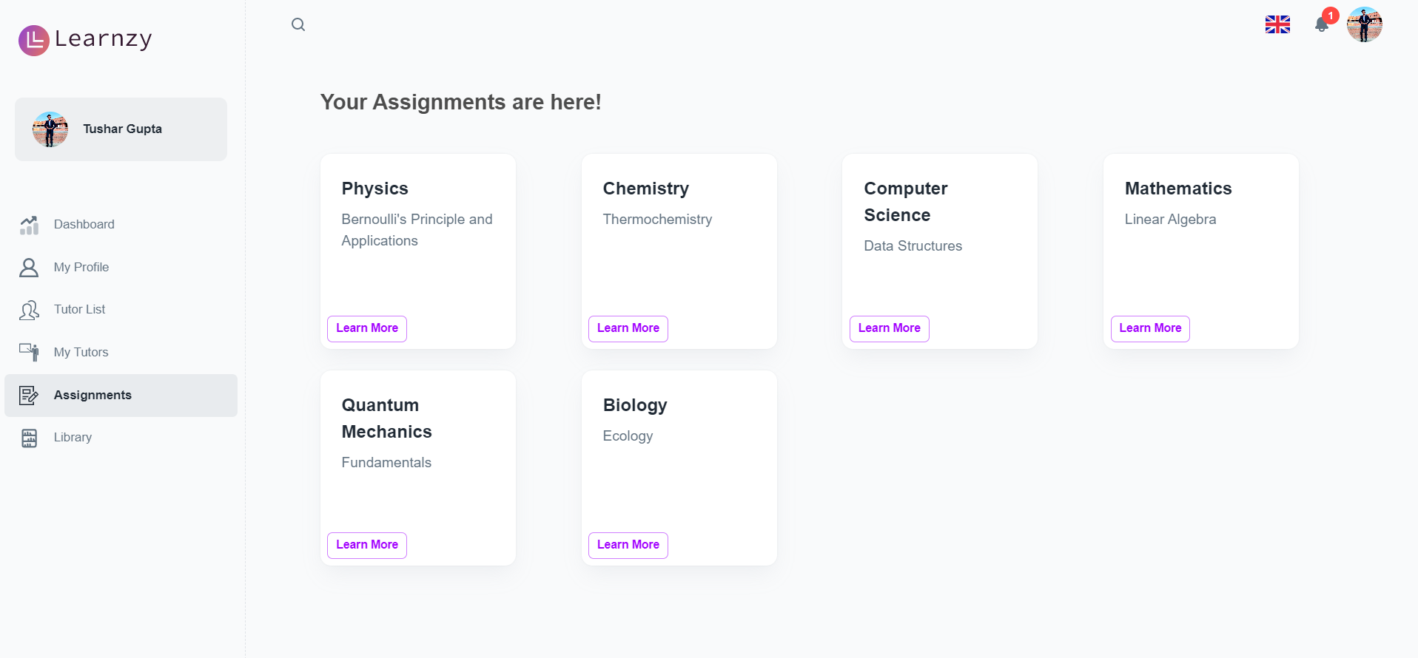
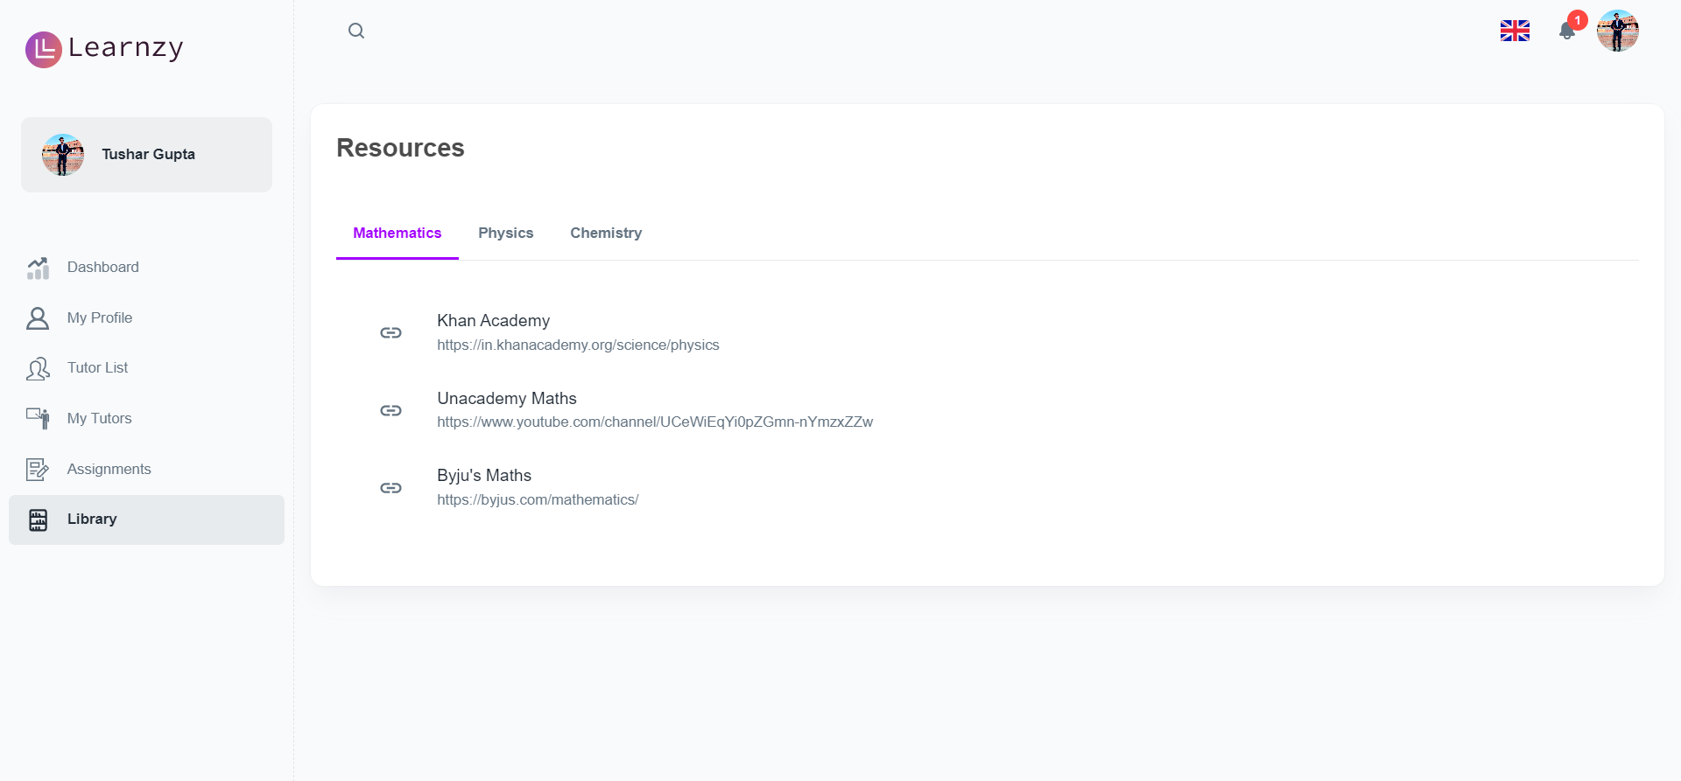
Student Dashboard
The student dashboard has the My profile section has the basic details specific to that student like the class, GPA, subjects learning, etc. which can be edited and updated in their profile section.
The Assignments section has the assignments uploaded by tutors specific to that student.
The Library section has resources and materials.

Slide 11
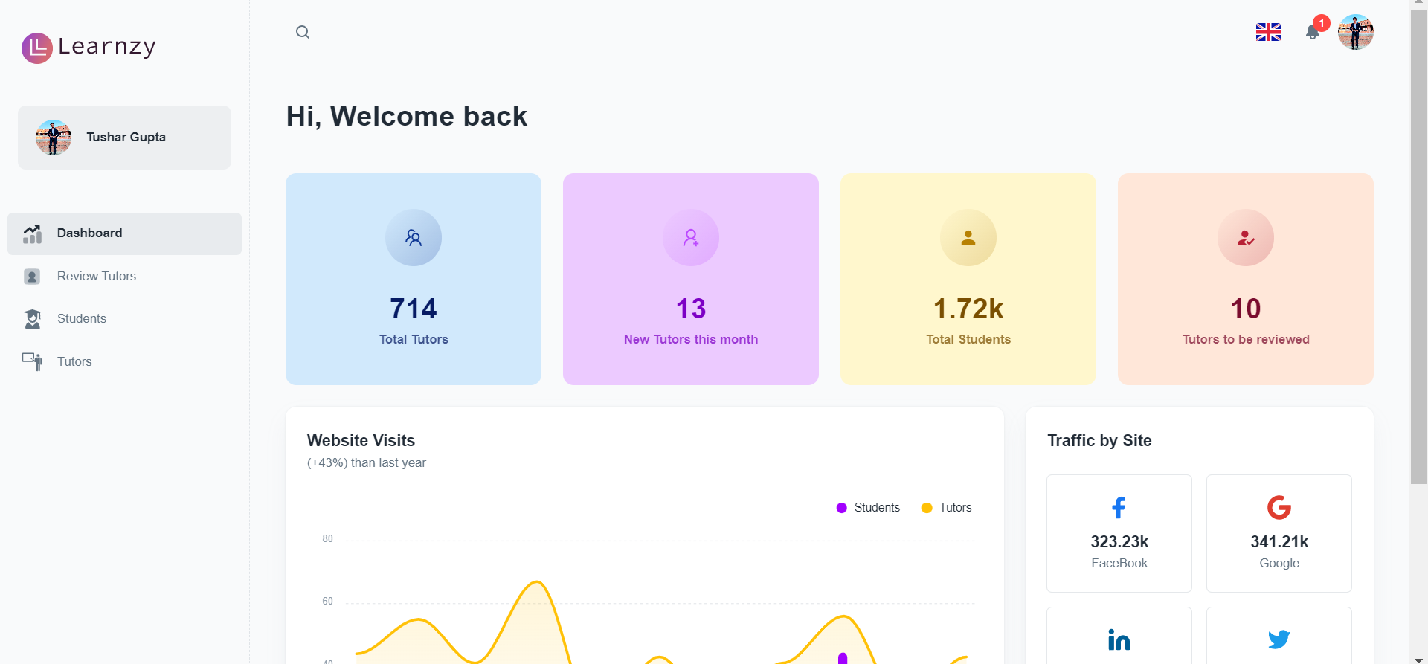
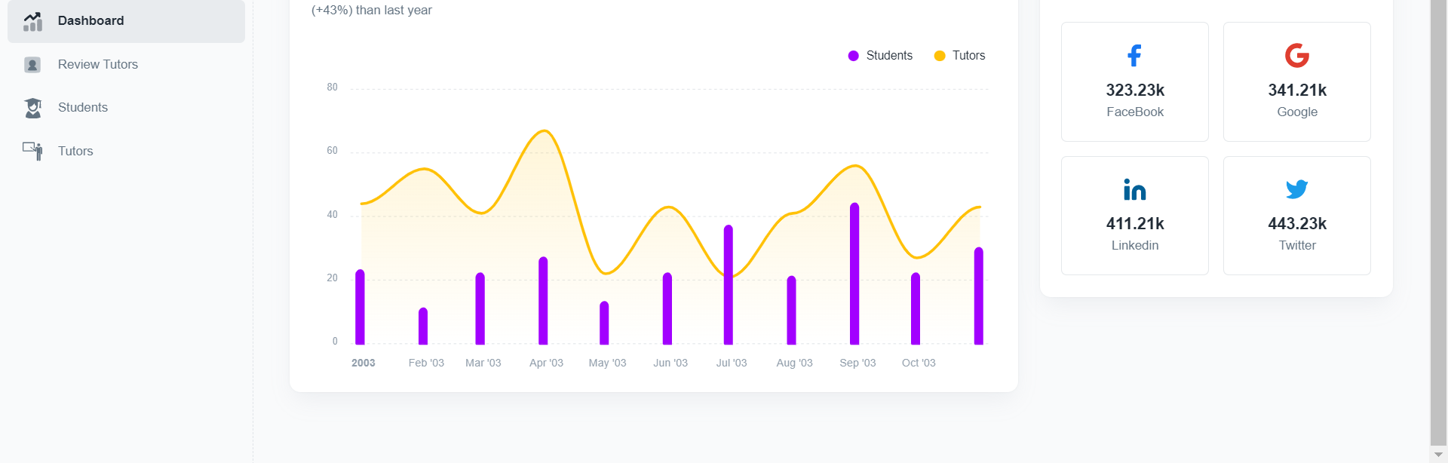
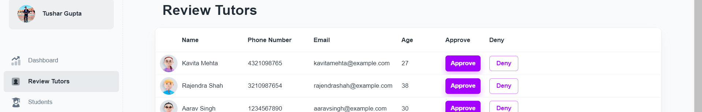
Admin Dashboard
The admin can view the analytics of the website, like the number of students, tutors, to-be-reviewed tutors, website visits and traffic.
The Review Tutors section has list of all tutors that sign up. The admin can approve or deny every tutor request. Only on approving the tutor details are stored in the database.

Slide 12
Team members Contribution
Aparna Nandakumar
Made 1 wireframe on tutor dashboard
Integrated 7 APIs
Worked on the Backend and Integration part of the Admin Dashboard: approve-deny functionality and listing all tutors and students)
Worked on listing data in the student and tutor dashboards(APIs)
Goutham TS
Made 3 wireframes
Made the UI for the landing page
Worked on the database schema and tested it on postman
Integrated 2 APIs for Add Tutor functionality in the student dashboard
Organised, managed the planner and handled client meets.
Daphnie Ritika
Made 3 wireframes
Did the My Profile Page in the Student dashboard and did the Figma design for two pages in admin dashboard.
Made the About us, Why us, Contact us pages on the landing page, all three directing to different pages.
Did the documentation of the first sprint and the final demo presentation.
Harshit Krishna
Made 2 wireframes
Designed the Student and Tutor sign-up pages using Figma and its front-end part.
Worked on the assignment upload functionality of the tutor dashboard using s3 bucket.

Slide 13
Team members Contribution
Nikitha Thatekalva
Made 3 wireframes
Designed the tutor dashboard and student dashboard in Figma.
Worked on the front-end of Tutor list and My Tutors of Student dashboard
Worked on database schema
Did the final demo documentation.
Piyush Kumar
Made 2 wireframes
Worked on the UI for the landing page
Worked on the routing of all pages
Integrated 2 APIs for the Assignment page.
Worked on displaying the Assignment data to Student dashboard.
Worked on front-end deployment
Piyush Geetesh
Made 3 wireframes
Worked on the video calling feature in the Tutor dashboard for live classes
Integrated 2 APIs for remote video calling.
Collaborated in the GET and POST request from the database for student data.
Shivang Gangwar
Made 2 wireframes
Did the Login, Sign-up, authentication for Student, Tutor and Admin Tables.
Integration of authentication with front-end
Integrated 8-9 APIs
Implemented cookie functionality using JWT token to make data dynamic in all pages.
Implemented logout functionality of Student and tutor.
Made Edit profile functionality working.

Slide 14
Team members Contribution
Vineet Begani
Made 3 wireframes
Made the coded UI design for 6 pages
Made complete 6 components of Student and Tutor dashboard
Worked on the Server Deployment
Worked with the integration of front end
Handled client presentation for sprint 2.
Tushar Gupta
Made 3-4 wireframes
Developed Layout for the Admin, Student, and Tutor Dashboard
Worked with Backend team extensively to integrate APIs and features on the frontend.
Updated Planner weekly
Handled Client Communication through email and Teams Meet
Developed various pages under Dashboard using Material UI
Led the frontend team

Slide 15


Thank you

